Slide 1


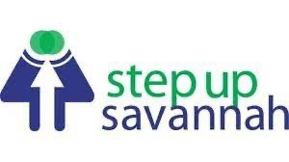




Community Mini-Grants Final Report
Grant dates: March 6-May 31, 2024
Prepared by Keeta Bell Jackson Spalding, July 2024

Slide 2
Grant Introduction
In March 2024, the Georgia Department of Human Services (DHS), in partnership with HOPE for Georgia Moms at Northeast Georgia Health System (HOPE), launched the “Stay Informed. Stay Covered.” Community Mini-Grant campaign.
This initiative offered community mini-grants to five organizations to help raise awareness about Medicaid/PeachCare for Kids® redetermination.
These grants leveraged local partner expertise to inform and educate difficult-to-reach populations across the state, with a specific focus on pregnant and postpartum women and children.

Slide 3
Award Categories
Community partners had previously asked for a mini-grants program to help spread the word about Medicaid redetermination and the program did consult partners in the formulation of the program.
Applicants could apply for one, multiple, or all grants up to $12,000:
$2,000 printing grant: to print and distribute approved campaign materials within the community.
$2,000 local advertising grant: to purchase and place approved ads within local publications.
$4,000 community event grant: to host a local event or to purchase and staff a booth at a larger event to raise awareness about Medicaid/PeachCare for Kids® redetermination.
$4,000 community staff supplement grant: to supplement community worker time to conduct outreach within the community.

Slide 4
Grant Publicity
The availability of the grant was promoted in several ways:
A press release distributed by DHS and HOPE for Georgia Moms to the media and approximately 200 community partners.
Social media posts on DHS and HOPE for Georgia Moms channels.
Presentations at DHS Community Partner Briefings, the Medicaid Unwinding Group, and HomeTown Health.
7 news articles published with geographic coverage of the state with a potential to reach 203,291 visitors.

Slide 5
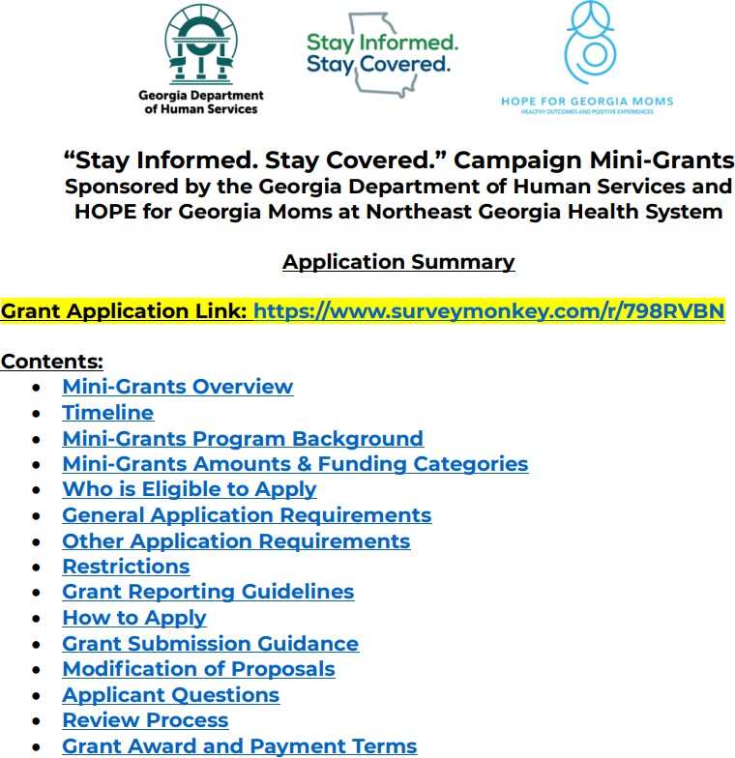
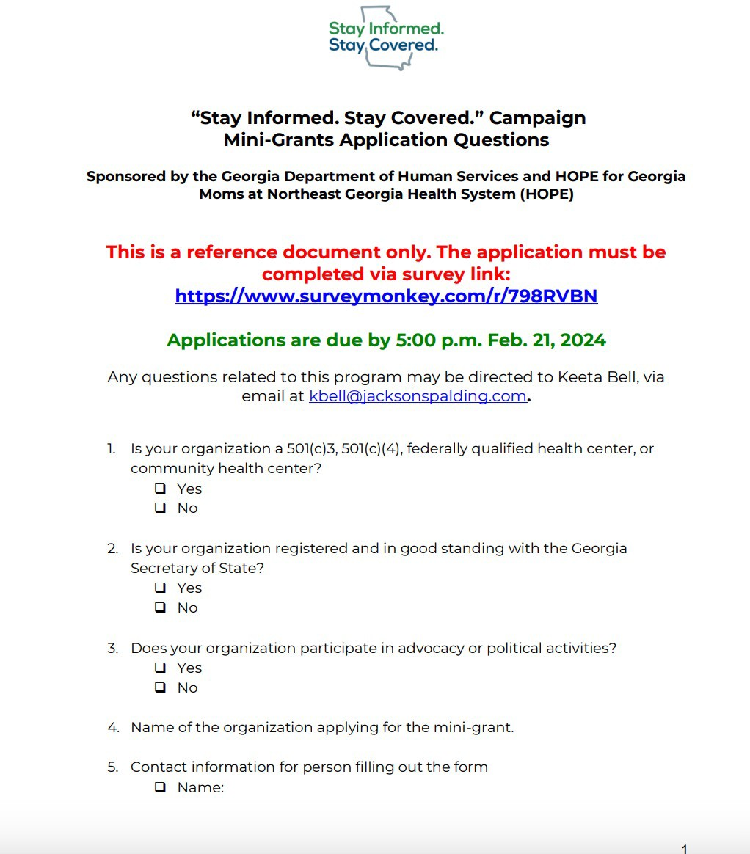
Grant Application Materials
Questions about the grant were answered via email and during a Community Partner Briefing on January 26.
A Grant Application Summary was provided to partners that detailed the grants’ timeline, eligibility criteria, restrictions, and other information.
Grant application questions were provided in a PDF to allow applicants to prepare before applying.
Grant Application Summary
Grant Applications Questions
Applicants applied through SurveyMonkey.

Slide 6
Grant Applicants
47 organizations applied from all over the state.
Applicant Geographic Breakdown:
6 from Atlanta
2 from Macon
2 from Columbus
The remaining organizations are distributed across various locations in Georgia.
7
6
5
4
3
2
1
0
Gainesville Conyers Smyrna Forsyth Decatur Dublin
Sa vannah
Albany Columbus Sa tesboro
Warner Robins
Rome Brunswick Fayetteville
Dalton Griffin
Jonesboro
Bryon Monroe Lithonia Clark ston Atlanta Kingsland Ringgold Covington Le esburg
Phe nix city, AL
Sylve ster Fort Valley Jackson
Macon Forest Park Norcross
Lithia Springs

Slide 7



























Populations Served
Applicants served a variety of communities. The top three populations served include:
10%
4% _{5%}
5%
10%
6%
9%
6%
7%
45 organizations serve families
8%
7%
8%
8%
7%
44 organizations serve people who are low-income
People who are refugees Suburban Communities
People with limited English proficiency People who are unhoused
Rural communities New borns/infants
People who are low-income
People who have serious chronic diseases People who are elderly
City-based communities School-aged children People with disabilities
Mothers (includes pregnant women) Fami lies
41 organizations serve
mothers (includes pregnant women)

Slide 8
Application Rubric
The JS team reviewed all applications prior to sending them to the committee to ensure eligibility criteria are met and to blind the applications.
The Mini-Grants Review Committee then judged the applications using the following scoring rubric:
 | Doesn’t Meet (0 pts) | Meets Slightly (3 pts) | Meets (5 pts) | Exceeds (7 pts) | Total Points
Organization’s current work strongly supports populations on Medicaid/PeachCare for Kids®
Organization already is conducting outreach on Medicaid/PeachCare for Kids® redetermination
Organization has presented a feasible plan to use the grant requested to raise awareness about redetermination
Organization serves low-income pregnant women or new mothers
Organization serves low-income children
Organization provides support to an underserved community (i.e., non-English speakers, rural audiences, or other groups)

Slide 9
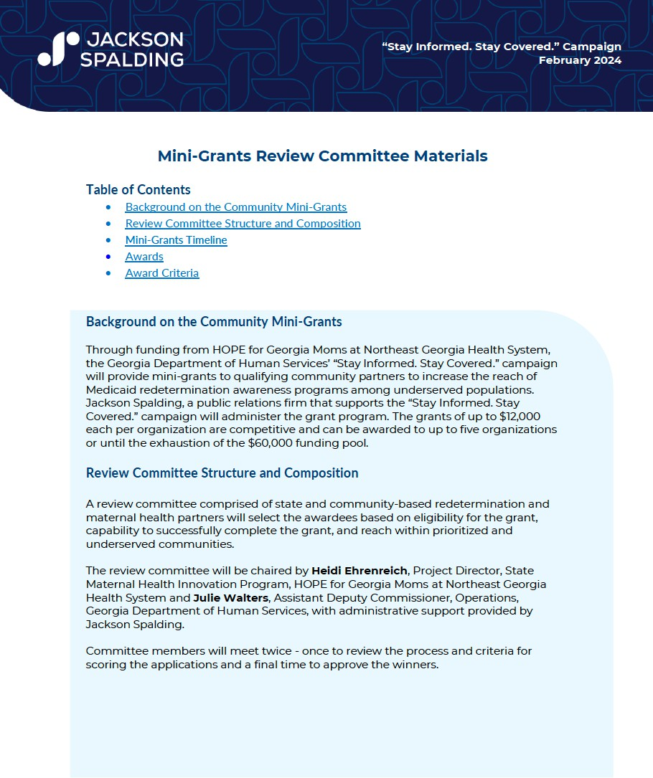
Grant Selection Process
Community and state agency participants were invited to serve on the Committee based on their involvement with Medicaid redetermination and ineligibility for the grant based on previously established criteria.
Co-Chairs (non-voting except in the case of a tie):
  Heidi Ehrenreich, Project Director, State Maternal Health Innovation Program, HOPE for Georgia Moms, Northeast Georgia Health System
  Julie Walters, Assistant Deputy Commissioner, Operations, Georgia Department of Human Services
Voting Members:
  Laura Beggs, Partnership and Collaboration Director, Georgia Department of Human Services
Brittney Newton, Senior Policy Analyst, Georgia VOICES
Lynnette Rhodes, Chief Health Policy Officer, Department of Community Health
Mary Lauren Salvatore, Assistant Director, Office of Whole Child Supports, Georgia Department of Education
Committee members received a formal orientation and a packet of instructions, including the criteria for grading the grants, as part of their invitation to participate.

Slide 10
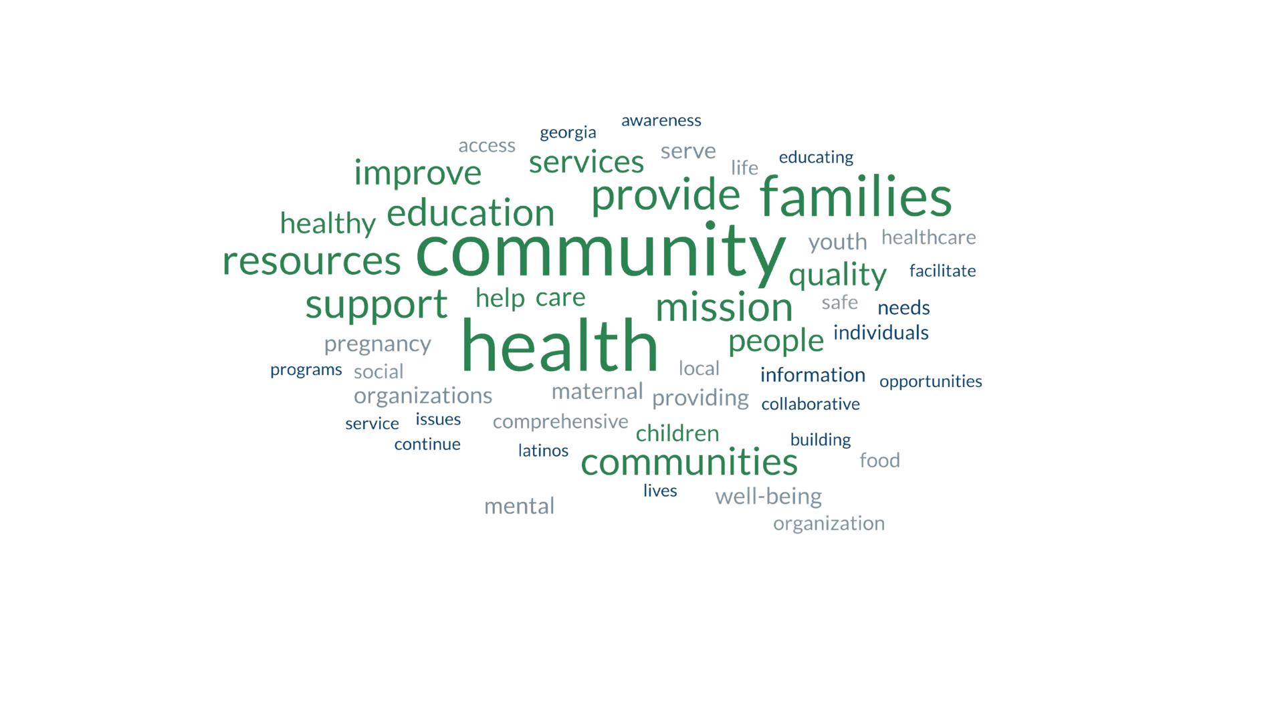
Applicant Organization Work Categories
Word cloud generated from the primary focus of the organizations as described in their mission statements.

Slide 11
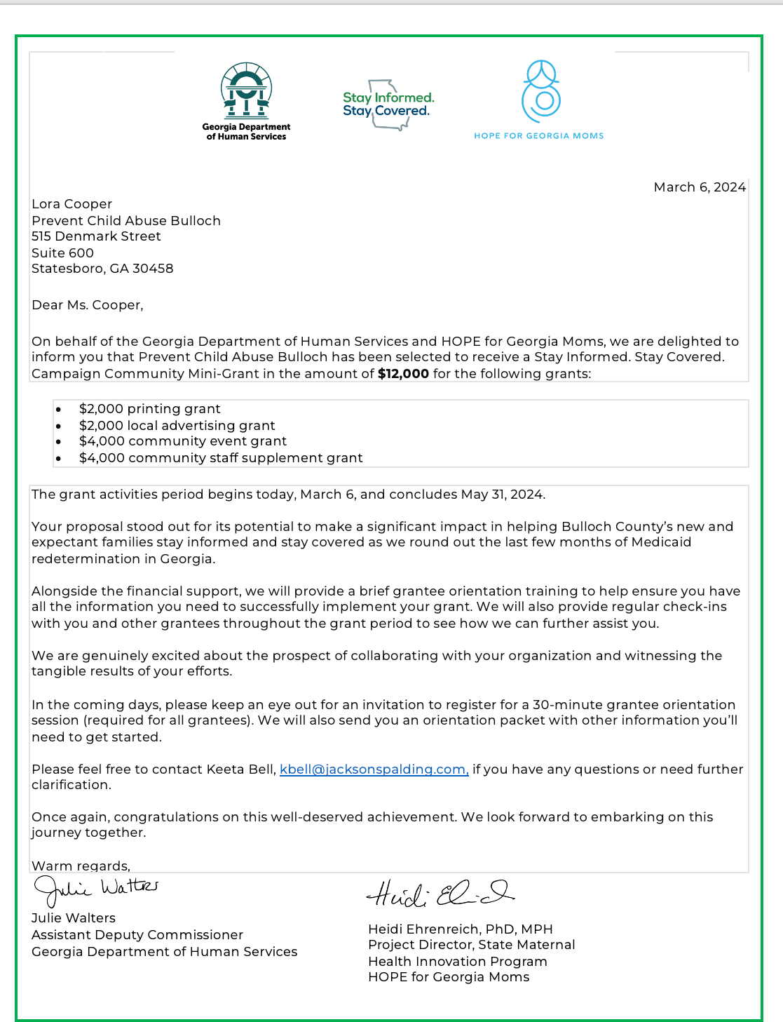

Grant Award Winners
Grant Review Committee members reviewed all 47 applications, which were blinded for the organizations name and five grantees were selected – each of them applying for the full $12,000.
Prevent Child Abuse Bulloch
Restoring the Breach, Inc.
The Fulton-DeKalb Hospital Authority
Northwest Georgia Hunger Ministries
Step Up Savannah
Notice of Award Letter Sample

Slide 12
Grantee Orientation Activities and Support
Grantees were oriented to the grant implementation process via:
An orientation packet including restrictions for use of funding, reporting templates and timelines, and resources to assist them with redetermination awareness.
An orientation meeting to cover the highlights of the program.
A training on Medicaid redetermination, with recommendations on what the partners could emphasize in their outreach.
Grantees were provided with several resources to assist them with publicizing and completing their grant:
Template press release announcing their award to share with local media.
Partner toolkit with social media, graphics, and collateral materials to use in their grant work.
Biweekly “open office hours” meetings to report on progress and ask questions.

Slide 13
Reporting and Financial Controls
Grantees are required to submit two activity reports:
A Halfway Report
A Final Report
They also are required to submit documentation of activities like photographs, videos, or news clippings either with their reporting or separately as needed.
Grantees are required to provide financial reporting in their Halfway Report and as part of requests for reimbursement or direct payment to a vendor.

Slide 14
Grant Implementation Timeline
ITEM
DATE
Award activity period begins | March 6, 2024
Grant awardees orientation | March 22, 2024
Mandatory 30-minute Medicaid redetermination trainings | March 27 or March 28, 2024
Submit Halfway Report | April 17, 2024
Final reporting date | May 31, 2024
End of award activity | May 31, 2024
Last date to submit reimbursements | June 28, 2024

Slide 15
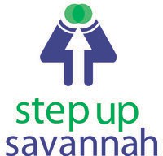
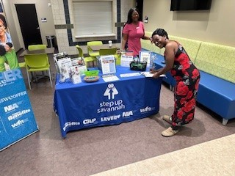
Step Up Savannah
“I think this was most needed because it was mindboggling to see how many participants [weren’t] aware of Medicaid redetermination.”
Step Up Savannah promotes economic opportunity and financial security in Chatham County, GA.
Established in 2005, the organization adapts and creates effective programs and products, trains neighborhood and nonprofit leaders, and advocates for policies that will improve the lives of low-income families.
The grant funds were used to host 13 Medicaid redetermination events in total (11 of the events were advertised through our flyers) and 2 newspaper ads that ran for 4 weeks. We had a large turnout at most of the events, with over 500 people in attendance, and assisting 146 participants with re-applying or checking their status for Medicaid.
These Medicaid redetermination events helped our senior population the most in Chatham Co. and the surrounding Counties (Byran, Liberty and Effingham Co.).
A key lesson learned was the necessity of having face-to-face interactions to raise awareness about Medicaid redetermination.

Slide 16

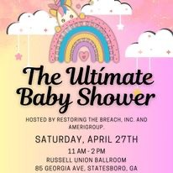
Restoring the Breach
Restoring the Breach is a faith-based 501(c)(3) corporation operating in the Statesboro-Bulloch County area committed to bestowing unconditional love through righteous acts by providing members of our community with tolls to help them build the life they want for themselves and their families.
The grant funds were utilized to host multiple events, engage in strategic advertising through social media and news outlets, and conduct direct outreach to community members in Bullock County.
These initiatives included a free household goods giveaway, a community baby shower, a family fun resource day, open computer lab hours, and the distribution of fliers to Statesboro Housing Authority residents, local apartment complexes, and businesses in the area.
The impact of these efforts was significant. Over 350 people attended the free household giveaway, direct assistance was provided to one person onsite with redetermination, and process instructions were given to 25 individuals. Over 140 families participated in the community baby shower. Social media ads reached over 65,000 people between April and May, while paid newsletter ads reached 31,000 subscribers daily in May.
“Thank you for the opportunity to provide Medicaid redetermination awareness to the Bulloch County community and surrounding areas. The support provided has allowed us to directly impact hundreds of families within our area and strive towards our mission of improving the quality of life of all of our citizens.”

Slide 17

Restoring the Breach cont’d.
Challenges included the need for computers and/or iPads during community outreach events to redetermine benefits more efficiently.
Lessons learned highlighted that Bullock County and the surrounding areas have a poverty rate of 20%, which impacts Wi-Fi availability and the literacy rate of residents. Medicaid redetermination awareness requires widely disseminated information in various forms to assist the most vulnerable populations.

Slide 18

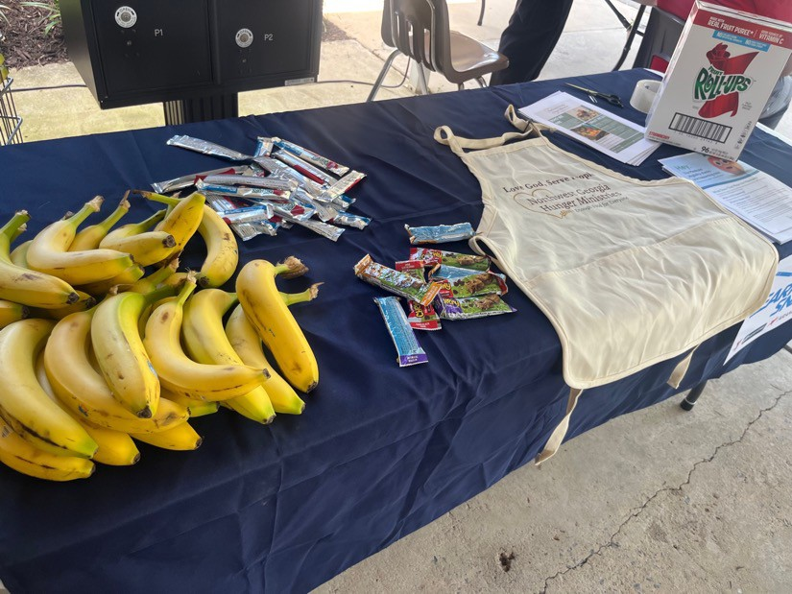
Northwest Georgia Hunger Ministries
“People seemed more receptive to the information and willing to login and get their benefits when at our food bank versus the general public.”
Northwest Georgia Hunger Ministries is a nonprofit that provides an extensive network of community partners and volunteers with the tools and expertise to lead fellow Georgians out of poverty.
The grant funds were utilized to staff several community events, set up an information table at the food pantry for a total of 27 days, compensate staff for their time, and place ads in the community.
The impact included reaching over 1,600 people through the client choice pantry and 1,100 individuals through community events.
Lessons learned emphasized that people benefit most from flyers and one-on-one direction, and having Wi-Fi available for individuals to log in was helpful.

Slide 19

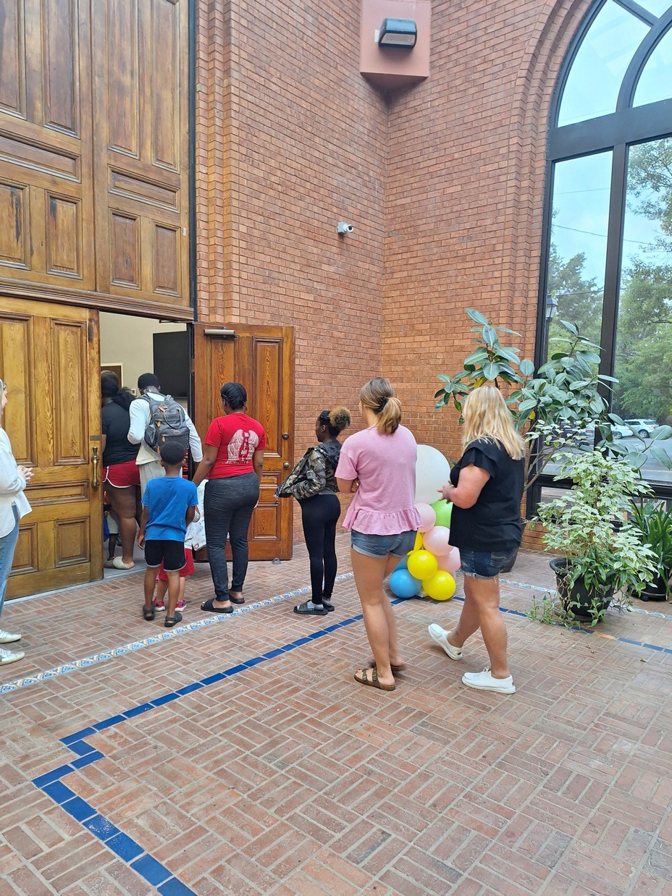
Prevent Child Abuse Bulloch
“People seemed more receptive to the information and willing to login and get their benefits when at our food bank versus the general public.”
Prevent Child Abuse Bulloch is a nonprofit organization committed to public awareness of and promoting the prevention of child abuse and neglect within the Bulloch County and surrounding communities.
The grant funds were used to print and distribute materials about redetermination in clinics, hospitals, doctors' offices, and other community locations. Information about redetermination was provided during their own programming, with free diapers offered at events to encourage learning about redetermination. Additionally, they spoke on local radio stations and hosted the Bump & Beyond Maternal Health Fair.
The impact included reaching approximately 1,500 individuals directly and tens of thousands indirectly. There was a noticeable change in behavior among residents who recognized the importance of completing the Medicaid redetermination process.

Slide 20
Prevent Child Abuse Bulloch cont’d.
Challenges faced included a limited time period, staff being unaware of the need for tablets or notebooks, and Medicaid redetermination falling off the radar for individuals.
Lessons learned highlighted the necessity for individuals to have access to someone who can answer questions and assist with the redetermination process.

Slide 21
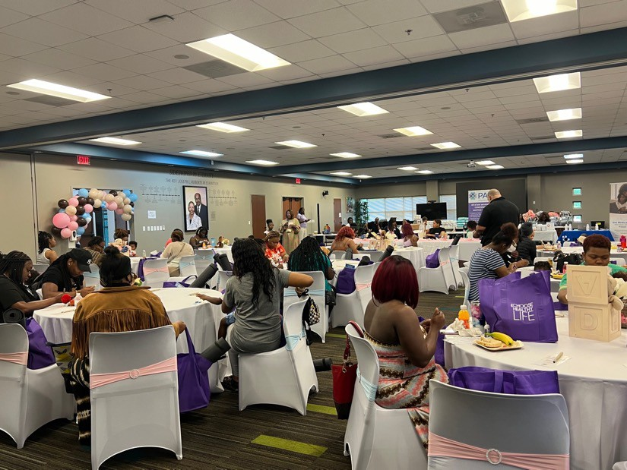

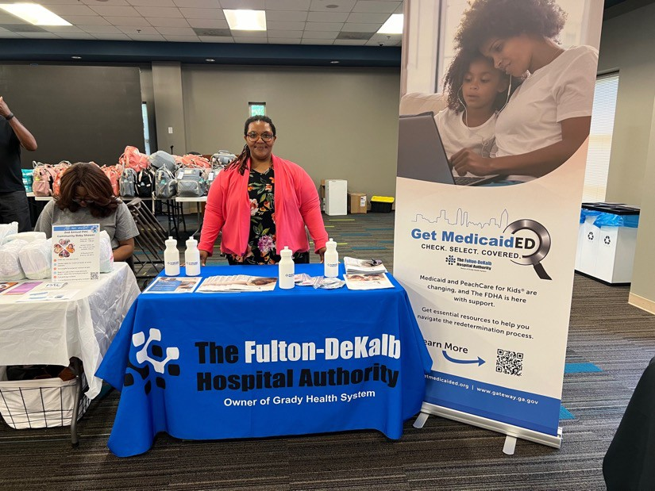
The Fulton-DeKalb Hospital Authority
“The mini-grant allowed our agency to better serve the Spanish speaking community by not only utilizing the materials that had previously been developed and made available on the Stay Informed, Stay Covered website, but enhanced our ability to create additional materials that served as conversation starters and were culturally tailored to the community.”
The FDHA sees access to quality prevention and care services as right for all, not a privilege for some. To this end, we’re working collaboratively with stakeholders from various sectors to strengthen the health ecosystem.
The grant funds were utilized to collaborate with key partners on community engagement events, allowing FDHA staff to share information about Medicaid redetermination. Community health workers were hired to conduct daily outreach and provide links to services. Additionally, a Medicaid redetermination social media awareness campaign was re-launched, featuring a PSA announcement and information for community members to connect with FDHA staff via their Medicaid website.
The impact of these efforts was significant: more than 200 people attended the Maternal Health Community Event, approximately 100 individuals attended the Community Baby Shower, and over 300 Spanish-speaking attendees participated in the Sports Fair at the Mexican Consulate. Additionally, around 400 English brochures and flyers, and 250 Spanish brochures and flyers were distributed, with an additional 100 placed at partner locations.
Lessons learned from these activities highlighted several challenges. Some community members were still confused about the process and didn’t take it seriously until it was too late. There was a lack of interpreter services, and some individuals were unable to read the written materials. It was noted that physician practices and schools should have taken a more proactive approach to educating about the redetermination process.

Slide 22
Acknowledgement
This program is supported by the Health Resources and Services Administration (HRSA) of the U.S. Department of Health and Human Services (HHS) as part of an award totaling $5,170,233 with 0% financed with non-governmental sources. The contents are those of the authors and do not necessarily represent the official views of, nor an endorsement, by HRSA, HHS, or the U.S. Government. For more information, please visit HRSA.gov.

Slide 23

THANK YOU.

