Slide 1
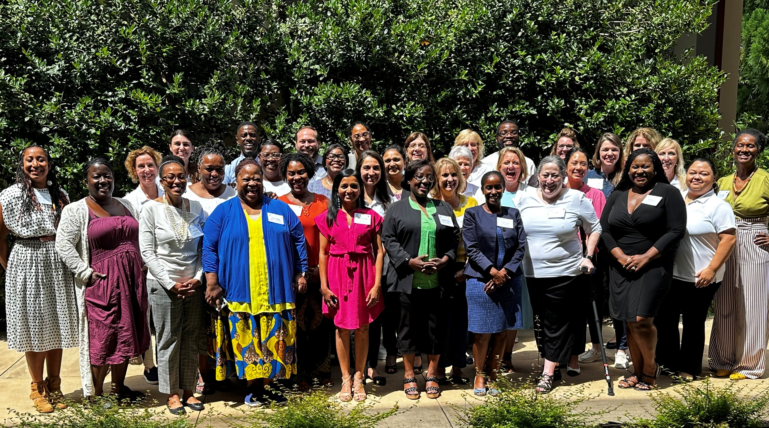
HOPE for Georgia Moms
Maternal Health Task Force
In Person Retreat
August 2, 2024

Slide 2
Objectives
Establish connections among Maternal Health Task Force members
Describe how HOPE serves as the desired quality of life for people who give birth in Georgia
Propose implementation timeline for strategies in 5 focus areas
Identify gaps in current plan and brainstorm new focus areas for FY25
Develop the final 5-year HOPE for Georgia Moms Strategic Plan

Slide 3
Agenda
7:00 - 8:00 am Continental Breakfast and Registration (Silverbell Pavilion)
8:00 - 9:00 am Welcome and Introductions (Silverbell Pavilion) Context of HOPE Strategic Plan
9:00 - 10:00 am Panel Speakers: Charles Johnson and Rose Horton
10:00 - 10:30 am Break – Videography
10:30 - 11:00 am Grounding for Breakout (Silverbell Pavilion)
11:00 - 12:10 pm Breakout Sessions (Silverbell Pavilion & Peachtree Creek in South Wing)
12:15 - 12:30 pm Round robin (Silverbell Pavilion)
12:30 - 1:30 pm Lunch (Emory Conference Center’s Dining Room)
1:30 - 2:00 pm Report-Outs on Focus Areas (Silverbell Pavilion)
2:00 - 3:00 pm Exploration of Gaps and Opportunities for FY25 (Silverbell Pavilion)
3:00 - 3:15 pm Break
3:15 - 4:00 pm Closing Reflective and Next Steps

Slide 4
HOPE for Georgia Moms Healthy Outcomes and Positive Experiences
Notes:
Reconnect on the meaning and value of HOPE-
This is our vision- the state we HOPE for

Slide 5
Group Agreements
Stay engaged- both today and after the meeting
Share the air- honor all thoughts and opinions
Take an inquiry stance and listen to understand rather than to respond
Speak your truth
Respect all thoughts
Expect and accept non-closure- prepare to leave with questions unanswered at times

Slide 6
Introductions
We are so excited to have everyone back together in person!!
Please share:
Your Name
Organization Name
Job title
One thing you HOPE to accomplish by the end of the retreat
Notes:
We are now a 5-hospital system – with a campus in Gainesville, Braselton, Winder and Lumpkin
We have 775 total beds across the four hospital campuses (Gainesville – 557, Braselton – 100, Barrow – 56, Winder – 52; Lumpkin – 10)
We also have seven urgent care facilities, 2 long term care centers and 6 rehab locations.

Slide 7
Never Ending Story Improv Icebreaker
We are going to create a story together
We are going to provide the first sentence of our story
Each member will add a sentence to the story until all members have spoken
"Once upon a time, a group of people from different backgrounds, cultures, and professions came together and formed a task force to improve Maternal Health equity and outcomes in Georgia”
Notes:
We also wanted to try a fun little icebreaker. So we are going to create a story together. We will provide the first sentence, then each person will add a sentence to the story until everyone has had a chance to add to the story. Does anyone have any questions?

Slide 8
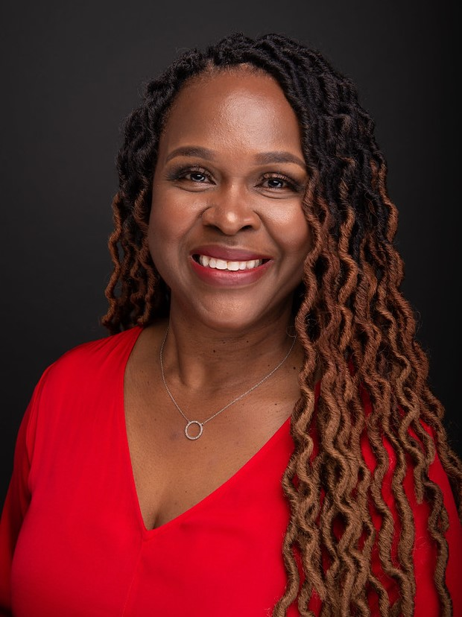
Panel Discussion
Charles Johnson
Founder of 4Kira4Moms and 4Kira4Dads
Rose Horton, MSN, RN,
NEA-BC, FAAN
Founder of #NotOnMyWatch campaign
Notes:
https://drive.google.com/file/d/1MD3s5ETYmhuvZmCuVDvonlUyCBsW6d0v/view?usp=sharing

Slide 9
Hope for Georgia Moms Respectful Equitable Care
Rose L. Horton, MSM, RNC-OB, NEA-BC, FAAN
Founder & CEO NotOnMyWatch Consulting Partners

Slide 10
“Mothers, the newborn and children represent the wellbeing of a society and its potential future. Their health needs cannot be left unmet without harming the whole of society.”
Lee Jong-Wook Director General World Health Organization (2005)

Slide 11
Global health experts agree that how people are treated during childbirth can affect the health and well-being of mothers, child and family…
(Vedam et al, 2019)

Slide 12
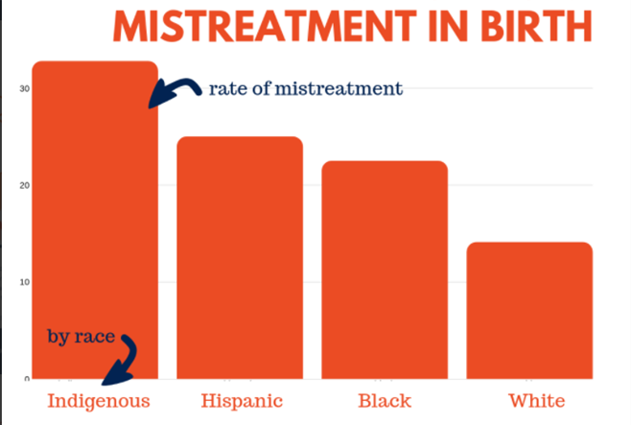
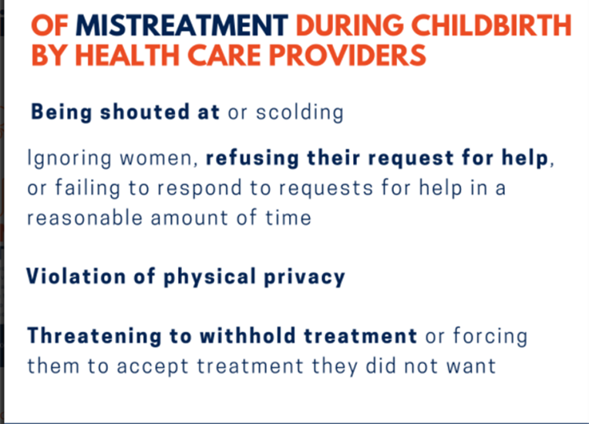
(Birth Place Lab, 2021. Retrieved from https://www.birthplacelab.org/mistreatment/)

Slide 13
CDC – Many Women Report Mistreatment During Pregnancy

Slide 15
Equity
Equality

Slide 16
Implicit Bias in Healthcare Professionals: A Systematic Review
Almost all studies found evidence for implicit biases among physicians and nurses. Based on the available evidence, physicians and nurses manifest implicit biases to a similar degree as the general population. The following characteristics are at issue:
race & ethnicity
gender
socio-economic status
age
mental illness
weight
intravenous drug users
social circumstance
Gerald & Hurst 2017

Slide 17
Black newborns more likely to die when looked after by White doctors
Rob Picheta, CNN, Updated 4:40 AM ET, Thu August 20, 2020

Slide 18
Racism
Prejudice and discrimination based on race. Attitudes and beliefs we have about a person or groups on a conscious (explicit) level.
A condition in society in which a dominant racial group benefits from the oppression of others, whether that group wants such benefits or not.
Wikipedia

Slide 19
AWHONN Respectful Maternity Care
Framework
Evidence-Based Guideline
Implementation Toolkit

Slide 20
Main Elements of the Guideline
Awareness
Mutual Respect
Shared Decision Making
Autonomy
Dignity
Accountability

Slide 21
Main Elements of the Guideline
Awareness
Mutual Respect
Shared Decision Making
Autonomy
Dignity
Accountability

Slide 22
Giving Voice to Mothers, 2019

Slide 23
Dignity & Respect
Listen to and Believe Women
Shared Decision Making
Evidenced Based Care
Advocate for Women & Birthing People

Slide 24
COMMITMENT

Slide 25
Time for a Group Picture!

Slide 26
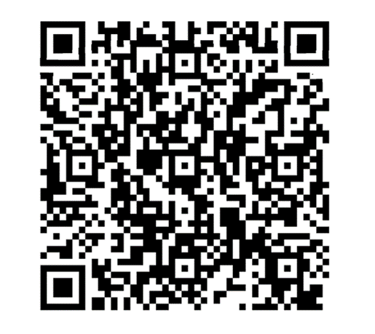
Break Time
Visit the Video/Photographer
We want to hear more from you!
Scan the QR on the back of your badge and complete the survey ☺

Slide 27
Georgia Maternal Health Data

Slide 28
Georgia’s Leading Causes of Pregnancy-Related Deaths 2019-2021
Leading Causes of Pregnancy-Related Deaths, 2019-2021 | Frequency
All Cardiovascular Conditions | 29
COVID-19 | 19
Hemorrhage | 16
Mental Health Condition | 14
Embolism | 11
There were a total of 133 pregnancy-related
The leading cause of maternal death was Cardiovascular Conditions
84.96% of pregnancy-related deaths were determined to be preventable by MMRC.
Notes:
July 30, 2021 by the American College of Obstetricians and Gynecologists (ACOG) and the Society for Maternal-Fetal Medicine (SMFM) and on August 11, 2021 by the Centers for Disease Control and Prevention (CDC).

Slide 29
Timing of Pregnancy-Related Deaths 2019-2021
Timing of Death | Pregnancy-Related Deaths | %
While pregnant | 32 | 24.06
Within 24 hours | 7 | 5.26
1-7 days postpartum | 24 | 18.05
8-60 days postpartum | 42 | 31.58
61-180 days postpartum | 10 | 7.52
181 days -1 year postpartum | 18 | 13.53
TOTAL | 133

Slide 30
Pregnancy-Related Mortality by Race/Ethnicity 2019-2021
Pregnancy-Related Mortality Ratio Per 100,000 Live Births
Non-Hispanic Black women | 58.7
Other/missing race/ethnicity women | 28.96
Non-Hispanic White women | 24.22
Hispanic women | 19.55
Total | 35.6

Slide 31
Severe Maternal Morbidity (SMM) 2019-2022
Severe maternal morbidity rates (SMM) including and excluding blood transfusions per 100 delivery hospitalizations at Georgia facilities, 2019-2022
 | 2019 | 2020 | 2021 | 2022
SMM including blood transfusions | 2.20 | 2.51 | 2.93 | 2.92
SMM excluding blood transfusion | 0.86 | 0.92 | 1.08 | 0.99

Slide 32
SMM by Race/Ethnicity 2019-2022
Severe maternal morbidity rates including blood transfusions per 100 delivery hospitalizations at Georgia facilities, by race/ethnicity, 2019-2022
Race/ethnicity | 2019 | 2020 | 2021 | 2022
White non-Hispanic | 1.71 | 1.76 | 2.21 | 2.1
Black non-Hispanic | 2.95 | 3.42 | 3.77 | 3.93
Hispanic | 1.91 | 2.6 | 3.12 | 2.95
Other | 2.03 | 2.39 | 2.88 | 2.89

Slide 33
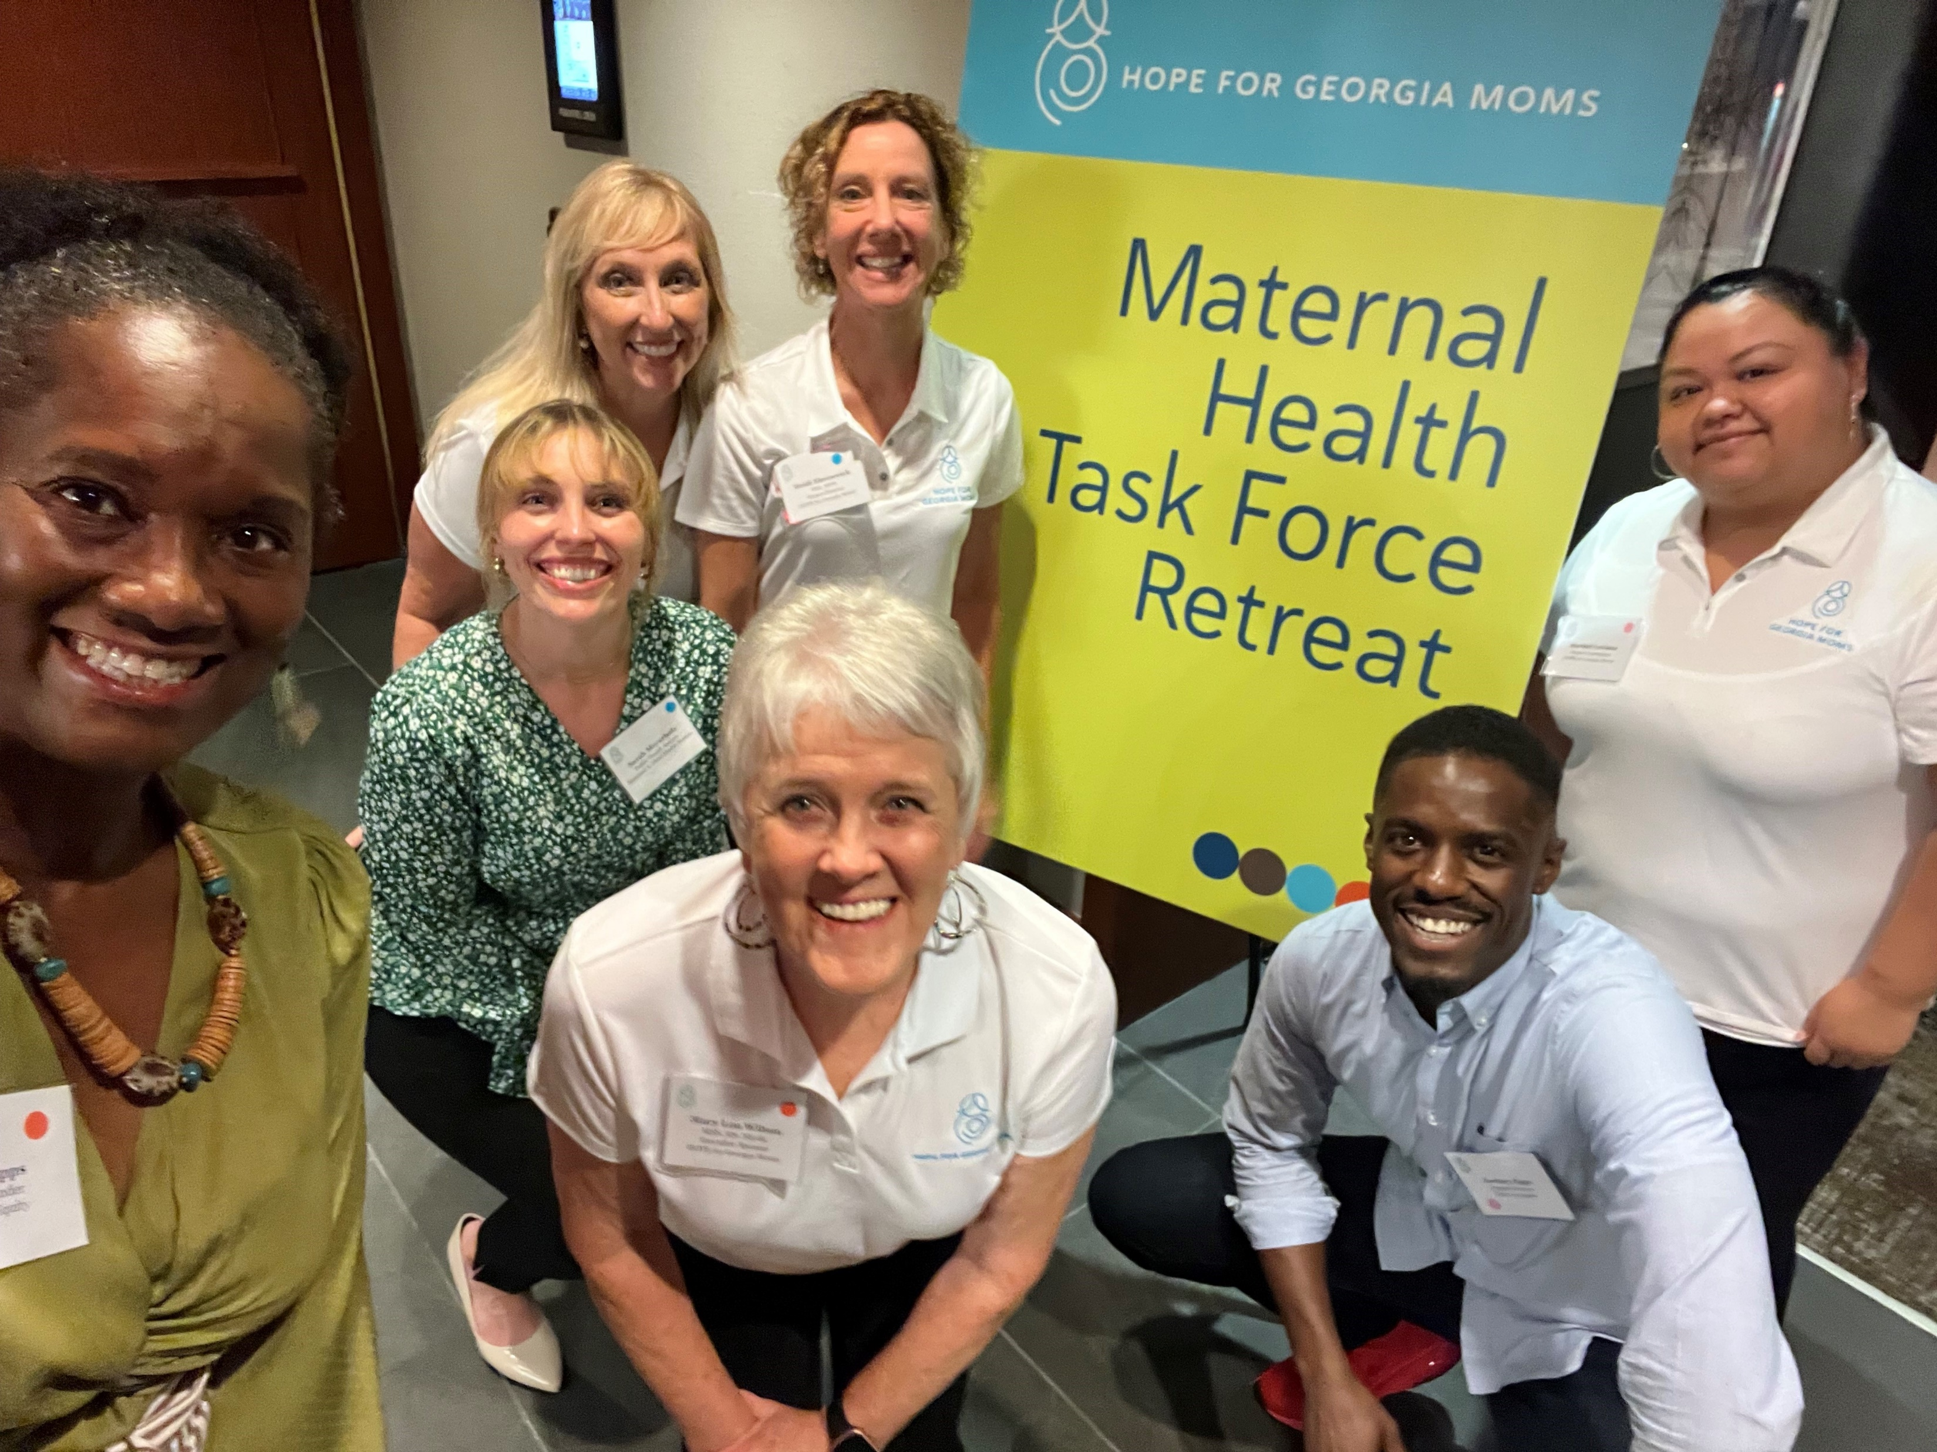
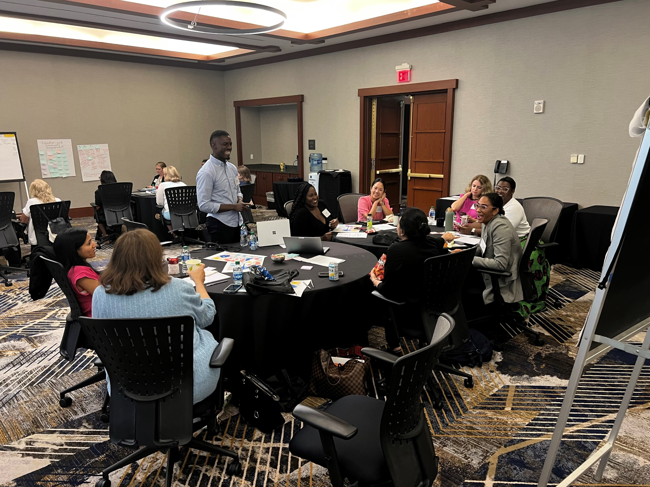
Progress from the First MHTF Retreat
Root causes that were identified at our last retreat that needed to be addressed:
Limited Access to care
Policy makers have little understanding, time, and courage to pursue health equity priorities
PWLE unable to share their stories / are they listened to?
Systemic racism and bias
Trust not there between clinical and perinatal support persons
Workforce shortages
Workforce silos

Slide 34
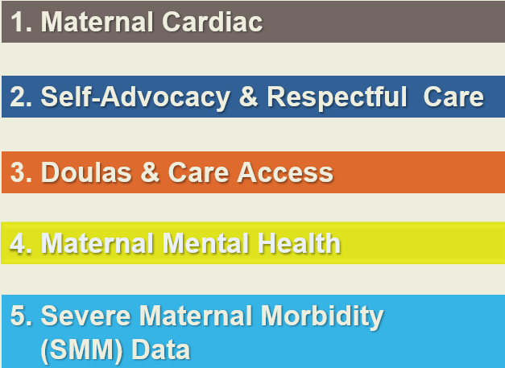
Focus Area FY24

Slide 35
Focus Areas Addressing Root Causes
Maternal Cardiac
Maternal Mental Health
Workforce silos
Workforce shortages
SMM / SDOH Data
Limited access to care
Limited Access to Care
Systemic racism & bias
Doulas & Care Access
Trust with healthcare
providers
PWLE sharing and being heard
Policymakers lack education or commitment
Self-advocacy/Respectful Care

Slide 36
Break Out Session

Slide 37
Breakout Instructions
Join your Subgroup
Maternal Cardiac – Bridgette/Sashoy (stay in Pavilion)
Maternal Mental Health – Astra/Brooke (stay in Pavilion)
SMM/SDOH Data - Jimmy/Ana (stay in Pavilion)
Self-Advocacy/Respectful Care – Heidi/Kelly (go to Peachtree Creek)
Doulas – Sherri/Maribel (go to Peachtree Creek)
Breakout session until 12:10pm
Meet back in the Pavilion 12:15pm
Round Robin 12:15-12:30 in the Pavilion

Slide 38
Regroup and Round Robin
Take some Post-It Notes and visit the 4 Focus Subcommittee’s Flip Charts that you did not participate in
Leave your comments, questions, ideas and feedback on each one

Slide 40
Time for Report Outs

Slide 41
Root Causes Already Identified
Are There Any New Ideas and/or Innovations to Address Them?
Limited Access to care
Policy makers have little understanding, time, and courage to pursue health equity priorities
PWLE unable to share their stories / are they listened to?
Systemic racism and bias
Trust not there between clinical and perinatal support persons
Workforce shortages
Workforce silos
Questions to Consider
What are new innovative and evidence-based ideas that could address the root cause?
What planning and resources would be require for new idea or innovation?
Are there current strategies that could be refined / expanded? (or need to end)?
Which of the ideas are low/no cost?

Slide 42
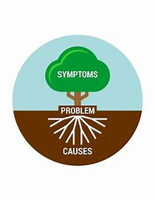
Root Causes NOT Already Identified
Questions to Consider
What other "problems" (root causes) needs to be addressed?
What factors contribute to things getting better?
What factors are hindering progress?
What are new ideas or innovations that could address new root cause?
Are there policies that lead to desired or undesired outcomes?

Slide 43
Prioritization
Collect the DOTS provided and review both flip charts created in the previous activity
Think about what topics should be focused on first in upcoming FY25
Take the DOTS provides and put them on the topics you think should be prioritize first
Each member can place 2 DOTS

Slide 44
Break
Time

Slide 45
Closing Reflection
Question 1:
In a word or short phrase, what do you appreciate about the time we have spent together today?
Question 2:
On a scale of 1-5, how would you rate the Maternal Health Task Forces’ progress toward finalizing the Strategic Plan?
Question 3:
What knowledge, insight, or wisdom have you gained from the meeting?
Notes:
Question 1: Word cloud
Question 2: Use post its, ask for volunteers to share, have facilitators pick up all sticky notes.
Question 3: Share thoughts

Slide 46
Before You Go
Parking pass validation
Next steps:
The finalizing strategic plan will be sent out to each Focus area Subcommittee members.
Please review and add your input- we really want to hear your thoughts!
Next Maternal Health Task Force Meeting is:
September 25th, 2024 from 12-1:30pm
Notes:
I close with gratitude. Everyone in this room knows we have gaps and opportunities in Georgia. But what I love about this picture is the idea of seeing what is there instead of what is NOT there
For me, I see a group of amazing, intelligent, committed and engaged men and women with the same share vision of HOPE
It is our greatest honor that you gave up your time today to work on a plan to improve Georigiaquity and outcomes for all the mothers of Georgia

Slide 47
Thank you!

